Slide 1
Business Requirements from Agile methodology tool
SDP Collateral
Part of Priorities and First Phase Deliverables
Notes:
<number>

Slide 2

Agenda
EDGE Agile Development v.10
Agilefant
HP ALM@ES with AANG
Agile Manager
Links
Notes:
<number>

Slide 3
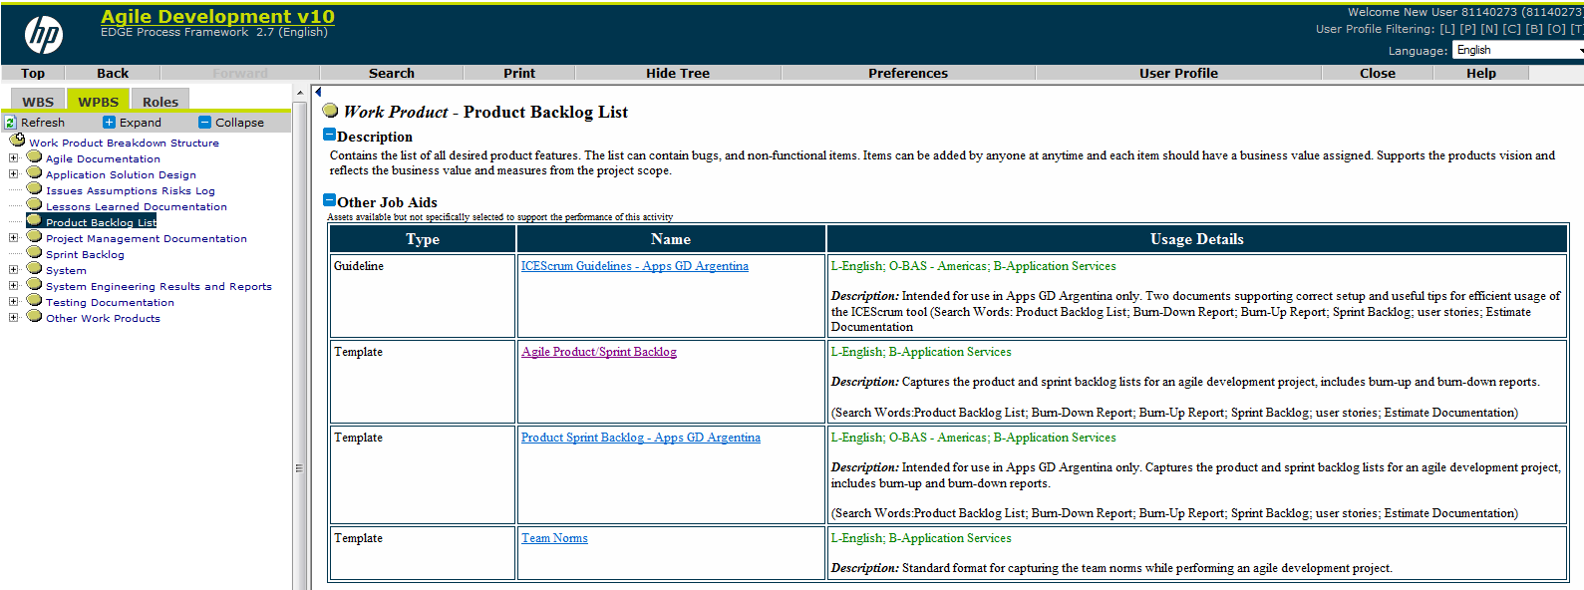
EDGE Agile Development v.10
Notes:
<number>

Slide 4
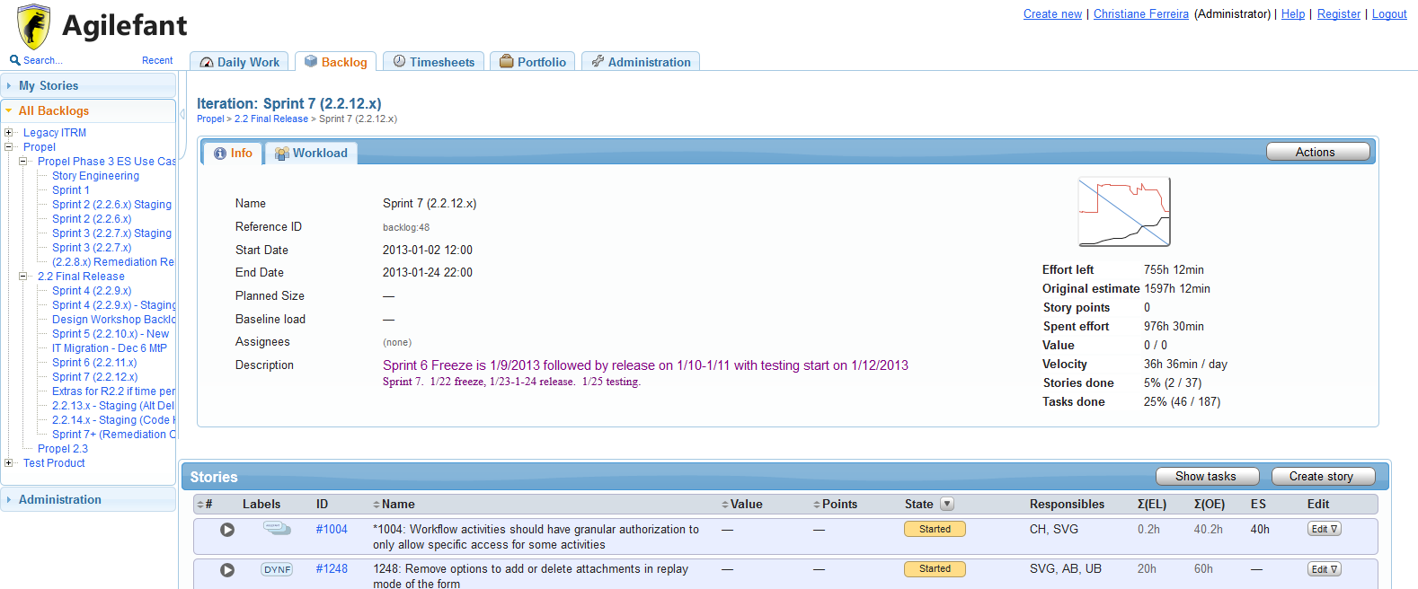
Agilefant

Slide 5

HP ALM@ES with AANG
Notes:
<number>

Slide 6
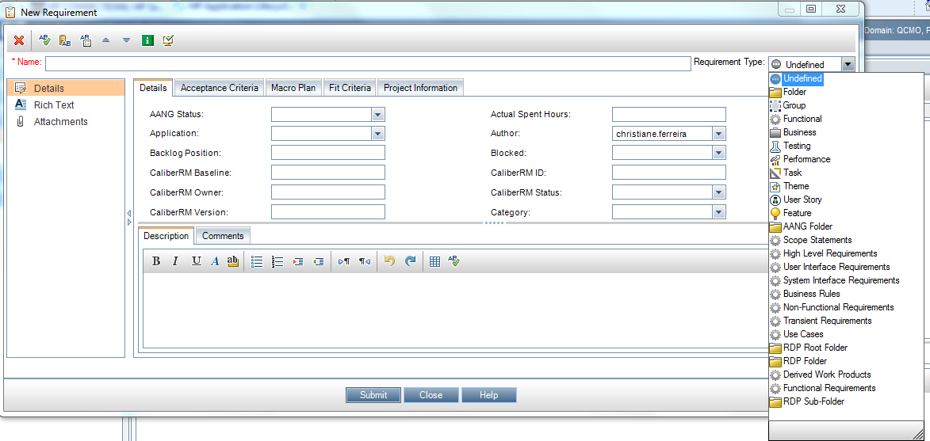
Requirements Type

Slide 7
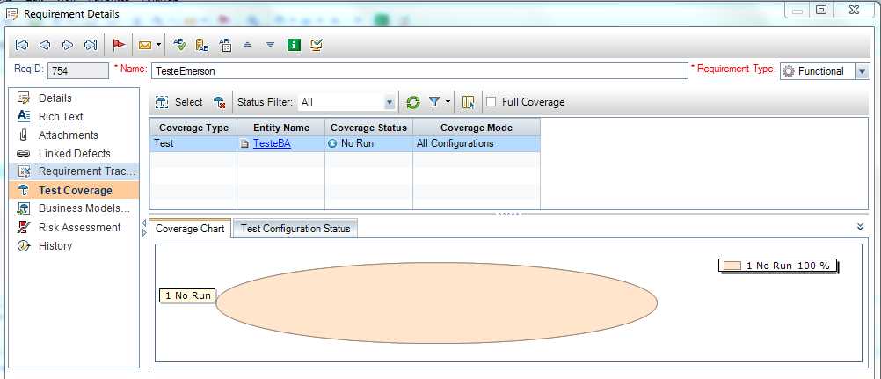
Requirements Details
Notes:
<number>

Slide 8
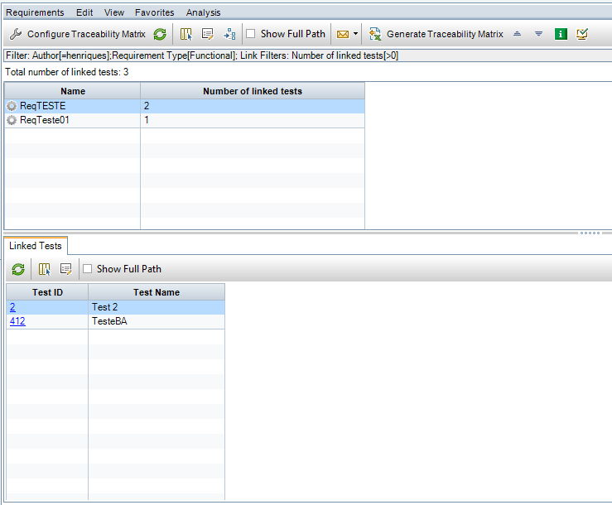
Traceability Matrix
Notes:
<number>

Slide 9
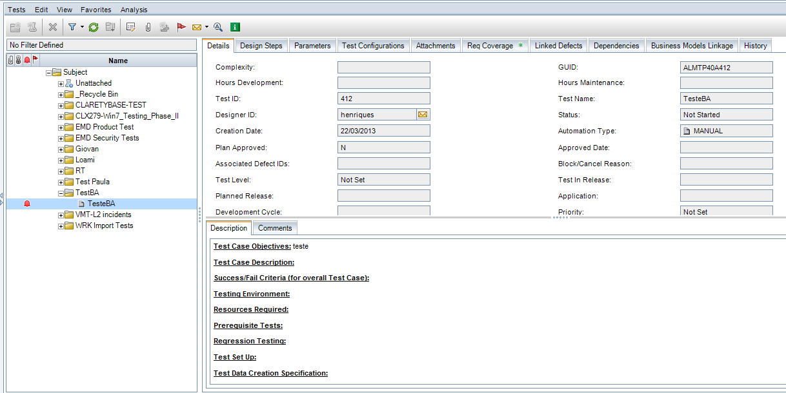
Tests
Notes:
<number>

Slide 10
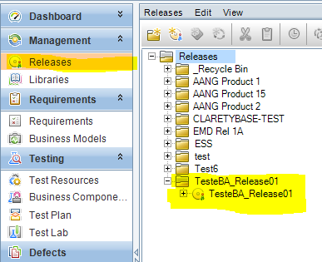
Release - Baseline
Notes:
<number>

Slide 11
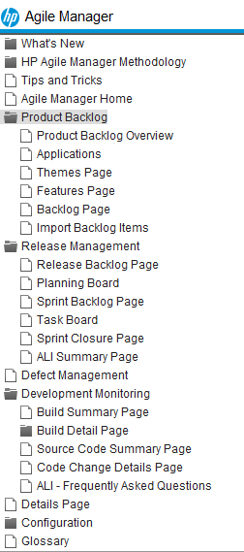
Agile Manager
“With regard to AANG, it currently plays a large role in the ALM@ES and EDGE method and tool sets. The EDGE team is examining ways it can incorporate HP Agile Manager into the methods and tools.” (March, 14)
Notes:
<number>

Slide 12
Products | Type | Integration | Pros | Cons
Edge Template: Product Backlog | Excel file | No integration | We can easily customize for the project needs. | No traceability without manual input. Too much effort to aggregate all information during the project lifecycle. Not reliable.
Agilefant | Tool | No integration | Based on Agile Methodology, easy and fast to input data. | No integration with other tools, no reports, no imports/exports.
ALM@ES - AANG | Tool / plug-in | AANG Integrated in the ALM@ES and is recognized by HP Edge Methodology | HP Agile Methodology to the ALM. Full project traceability. Integrates with Starteam (repository) and Together. | Slow to load, not easy to maintain (depending on the amount of information). Maybe need some fields customization for requirements or others. Need input from other areas to have the complete traceability. Need a lab/test to explore the integration with AANG.
HP Agile Manager (Service Solution – SaaS) | Tool | No integration | Based on Agile Methodology. Not able to validate the tool but seems that provide a full management/traceability during the project lifecycle. | EDGE team is examining ways to incorporate HP Agile Manager into the methodology and tools.

Slide 13
Links
EDGE - Agile Development v10: http://pve.corp.hp.com/app/viewer/appl/pview.htm?item=19671&RememberMe=false
HP Agile Manager Help center: https://agilemanager-docs.saas.hp.com/agmdocs/
HP ALM@ES:
http://intranet.hp.com/enterpriseservices/ww/wg/functions/HPEDGEPlatform/Operations/Tools/Pages/HP_ALM.aspx
ALM ES: http://qc3d.atlanta.hp.com/qcbin/start_a.jsp
Agile Accelerator Next Generation (AANG):
http://intranet.hp.com/enterpriseservices/ww/wg/functions/HPEDGEPlatform/Operations/Tools/Pages/AANG.aspx

Slide 14
Thank you
Notes:
<number>

